Slide 1
G3P3 Operating Modes
Kevin Albrecht
2/17/19

Slide 2
G3P3 Process Flow Diagram

Slide 3
Receiver Startup

Slide 4
Receiver Steady State Operation

Slide 5
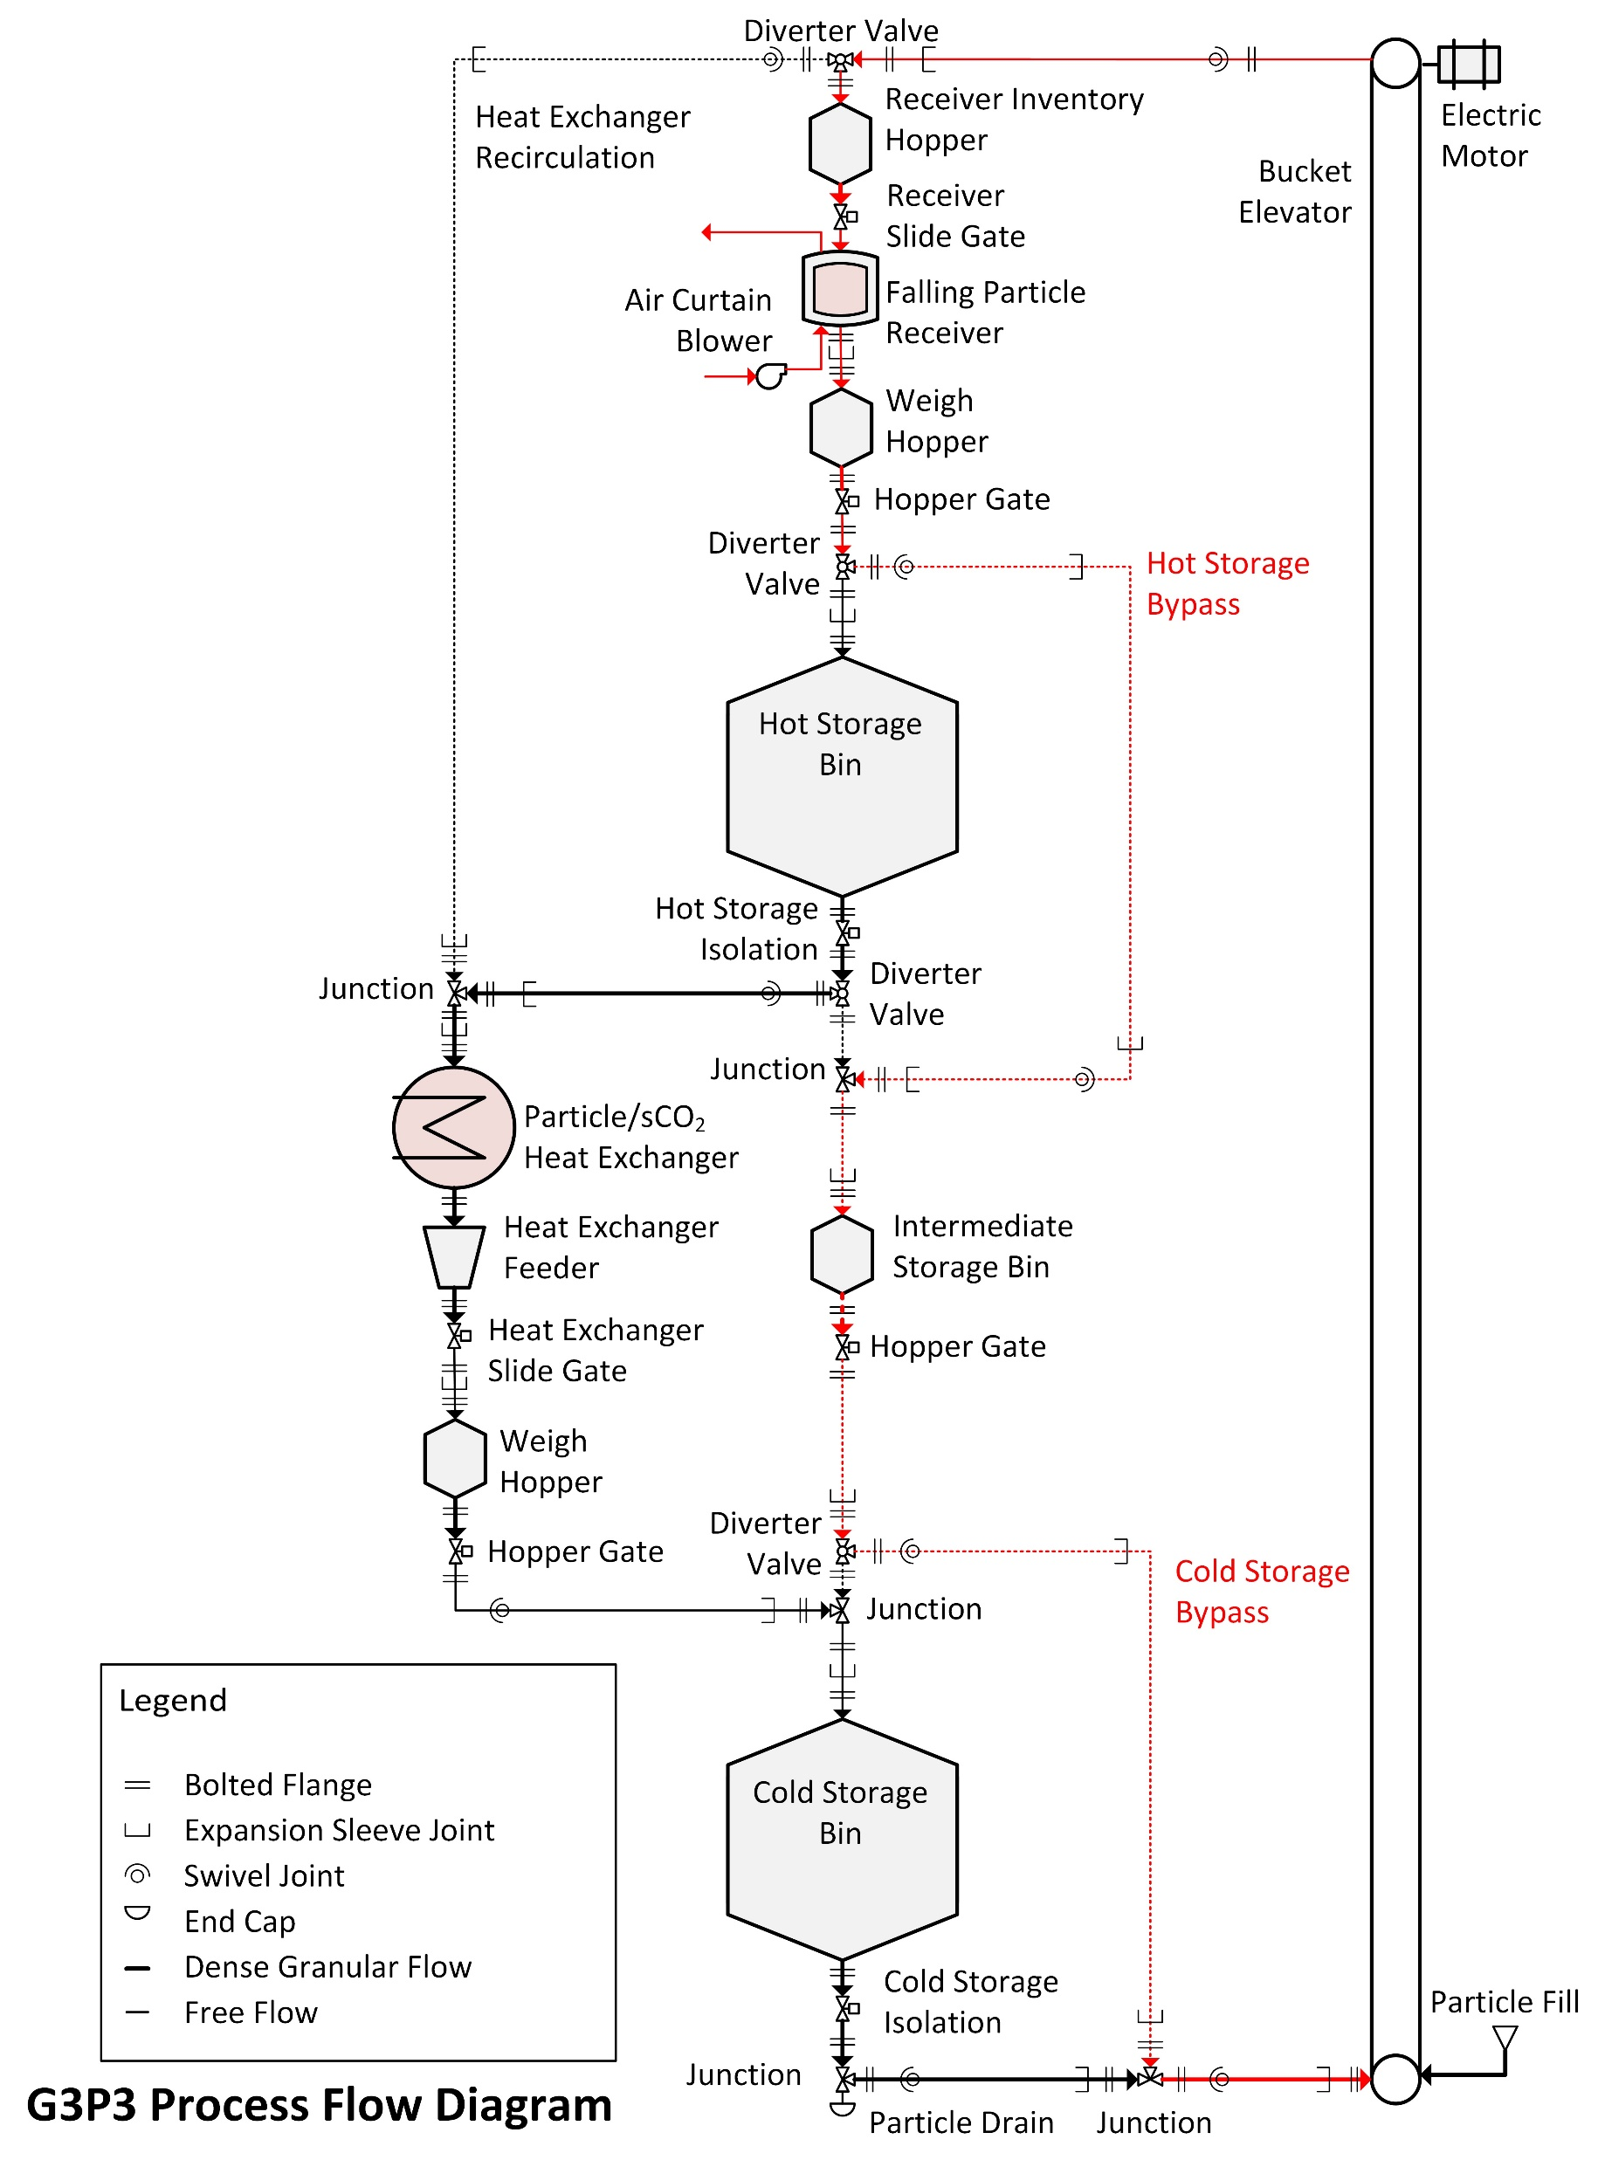
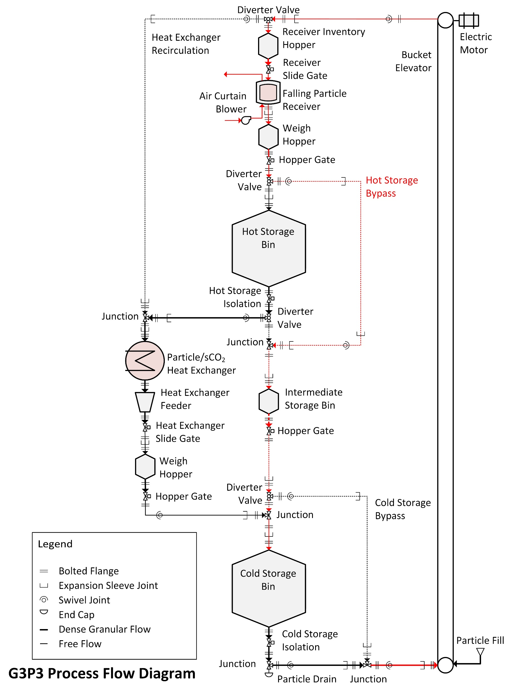
Receiver Shutdown/Idle

Slide 6
Drain Intermediate Storage

Slide 7
Heat Exchanger Maintenance Heating

Slide 8
Heat Exchanger Startup

Slide 9
Heat Exchanger Steady State

